Slide 1
Beta Meeting
October 2, 2025

Slide 2
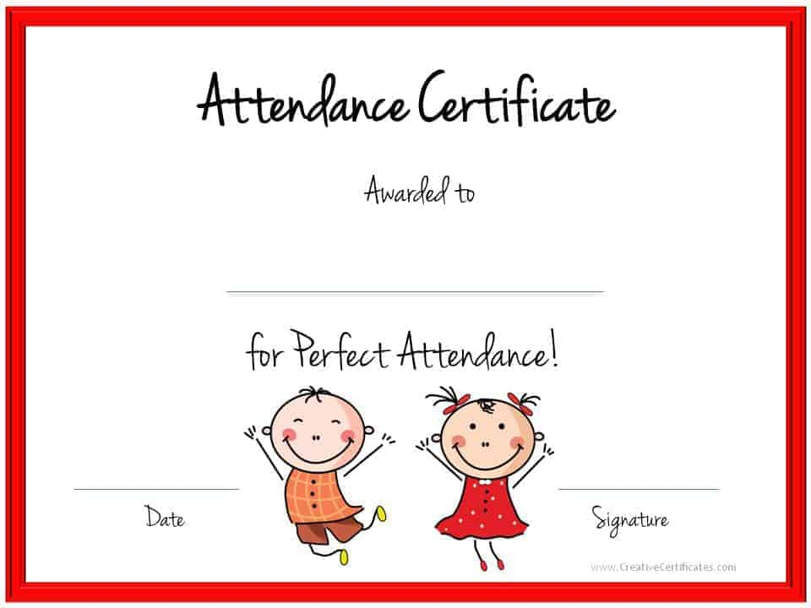
Good morning!
Open Remind and fill out the Microsoft form to take attendance
This Photo by Unknown Author is licensed under CC BY-SA

Slide 3
Beta Officer Videos –
Presidential Candidates - Isaiah F., Makenzie P., Maci C.
VP Candidates – Odyxy V., Addelaide J.
Secretary Candidates – Aarya C.
We will watch the videos today. A form will be sent out through Remind later today for you to cast your votes!

Slide 4
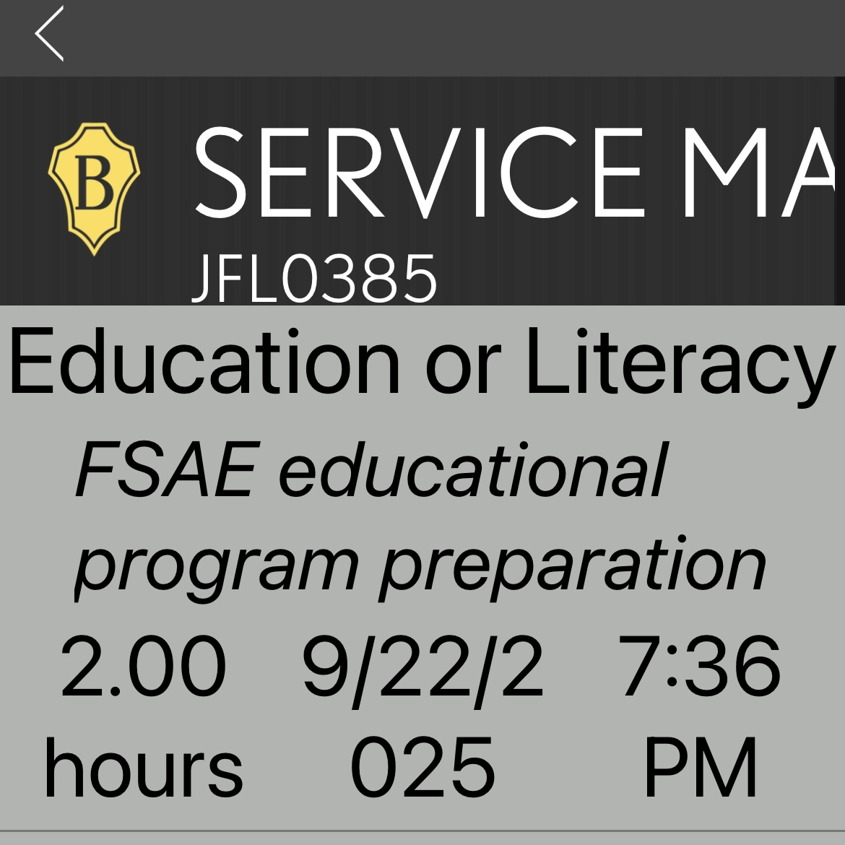
WHEN ENTERING HOURS……
Pick a topic from the list that your service falls under
Tell us what the service was!!!
Here is an example of the correct way to do this

Slide 5

October is Breast
Cancer
Awareness Month
If you have on pink today you may put in one hour for Civic Engagement

Slide 6

Start selling TODAY!
Forms and payment are due on 10/22
Coffee can be picked up on 11/12
There are prizes for the top 3 sellers!

Slide 7
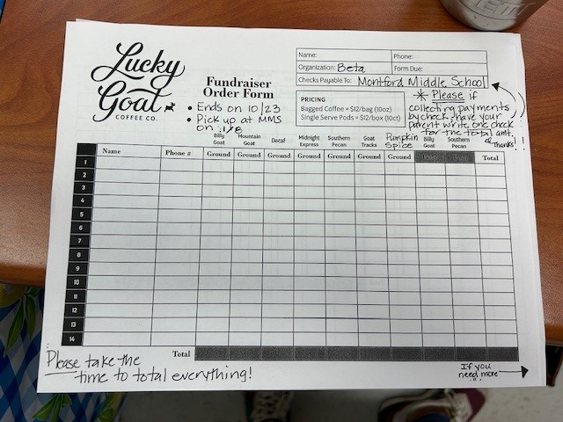
Sell and collect $
Ask everyone, family, friends,
Teachers.
Collect money as you go.
Have people Venmo your parents,
Write a check to your parents, give
Your parents cash
THEN!! Have
Your parents write
One check for the total to MMS.

Slide 8

Looking ahead to November:
We are co-sponsoring a toy drive with Student Government.
We will be collecting new toys for Toys for Tots
Each toy will count as 2 hours
TOYS FOR TOTS CANNOT DISTRIBUTE PLAY-DOH, REALISTIC LOOKING WEAPONS AND GIFTS WITH FOOD!

